Slide 1


DESIGN AND ANALYSIS OF ALGORITHMS LABORATORY WITH MINI PROJECT [19IS4DLADA ] Presentation on “ SUDOKU SOLVER ”
Presented By
Student Name USN
LAB IN-CHARGE
Mrs. Bindu Bhargavi S M
Mrs. Shilpa Shree S
Mrs. Sreevidya B S
APOORVA SV 1DS19IS020
ANITHA P 1DS19IS017
KRUTHI R AITHAL 1DS19IS052 MANASA B 1DS19IS054

Slide 2
CONTENTS
Introduction
System Requirements
Algorithm
Implementation
Pseudocode
Snapshots of Results
Time Complexity

Slide 3
INTRODUCTION
RULE TO SOLVE SUDOKU
Fill the sudoku(9x9) with numbers 1 to 9, keeping in mind that the same number doesn’t repeat in particular column ,row or 3x3 box.

Slide 4
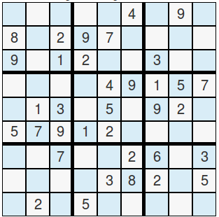
9X9 SUDOKU
COLUMN
ROW
3X3 BLOCK

Slide 5
System Requirements
Min RAM Size : 4 MB
Min Hard Drive Space : 25 MB
OS Required : Microsoft DOS, Microsoft Windows 3.1 or later, PC DOS
OS Family : Windows
Min Processor Type : Intel 386 or higher

Slide 6
BACKTRACKING ALGORITHM
A backtracking algorithm is a problem-solving algorithm that uses a brute force approach for finding the desired output.
(The brute force approach tries out all the possible solutions and chooses the desired solution.)
The term backtracking suggests that if the current solution is not suitable, then backtrack and try other solutions. Thus recursion is used in this approach.

Slide 7
BACKTRACKING ALGORITHM
1.Assign numbers one by one to empty cells.
2.Before assigning, we check if it’s safe or not.
3.After checking for safety, we assign the number and recursively check whether this assignment leads to a solution or not.

Slide 8
BACKTRACKING ALGORITHM
*Find the position i.e. row, column of an unassigned cell
*If there is none
return true
otherwise For digits from 1-9
*If there is no conflict for digit at row, column and the 3x3 grid, then assign digit to row, column and recursively try to fill in the rest of the grid.
*If recursion is successful
return true
else
remove digit and try another

Slide 9
IMPLEMENTATION
// CHECKING IF SUDOKU IS SOLVED
int isSolved(int prob[][3][3]) {
int flag = 1, b1, sum, b, i, j, sudo[3] = { 0, 3, 6 };
for (b1 = 0; b1 <= 2; b1++)
for (i = 0; i <= 2; i++) {
for (sum = 0, b = sudo[b1]; b <= sudo[b1] + 2; b++)
for (j = 0; j <= 2; sum += prob[b][i][j], j++)
;
// IF SUM IS 45
sum != 45 ? flag = 0 : NULL;
}
return flag;
}

Slide 10
// BACKTRACK ALGO
int solve(int prob[][3][3], int block) {
int i, j, row = 999, col = 999;
if (block == 9) {
isSolved(prob) ? print(prob) : NULL;
return 0;
}
for (i = 0; i <= 2; i++)
for (j = 0; j <= 2; j++)
if (prob[block][i][j] == 0) {
row = i;
col = j;
goto xx;
}
xx: if (row == 999 && col == 999) {
solve(prob, block + 1);
return 0;
} else {
for (i = 1; i <= 9; i++)
if (canPut(prob, block, row, col, i)) {
prob[block][row][col] = i;
solve(prob, block);
prob[block][row][col] = 0;
}
}
return 0;
}

Slide 11
START
FLOW CHART
READING SUDOKU
SEARCH PATTERNS
MAKE A SMART GUESS
No
FOUND
Yes
TAKE NECESSARY ACTION
SOLVED
No
Yes
PRINT SOLUTION
STOP

Slide 12
COMPLEXITY ANALYSIS
Time Complexity:
O(n ^ m) where n is the number of possibilities for each square (i.e., 9 in classic Sudoku) and m is the number of spaces that are blank. The recurrence equation can be written as
T(M) = 9*T(M-1) + O(1)
where T(N) is the running time of the solution for a problem size of N. Solving this recurrence will yield, O(9^M).
Space complexity:
it’s the recursion stack that is used as an auxiliary space which is N*N step deep. Remember we need to fill in 81 cells in a 9*9 sudoku and at each level, only one cell is filled. So, space complexity would be O(M).

Slide 13
ADVANTAGES
A solution is guaranteed (as long as the puzzle is valid).Solving time is mostly unrelated to degree of difficulty.
The algorithm (and therefore the program code) is simpler than other algorithms, especially compared to strong algorithms that ensure a solution to the most difficult puzzles.

Slide 14
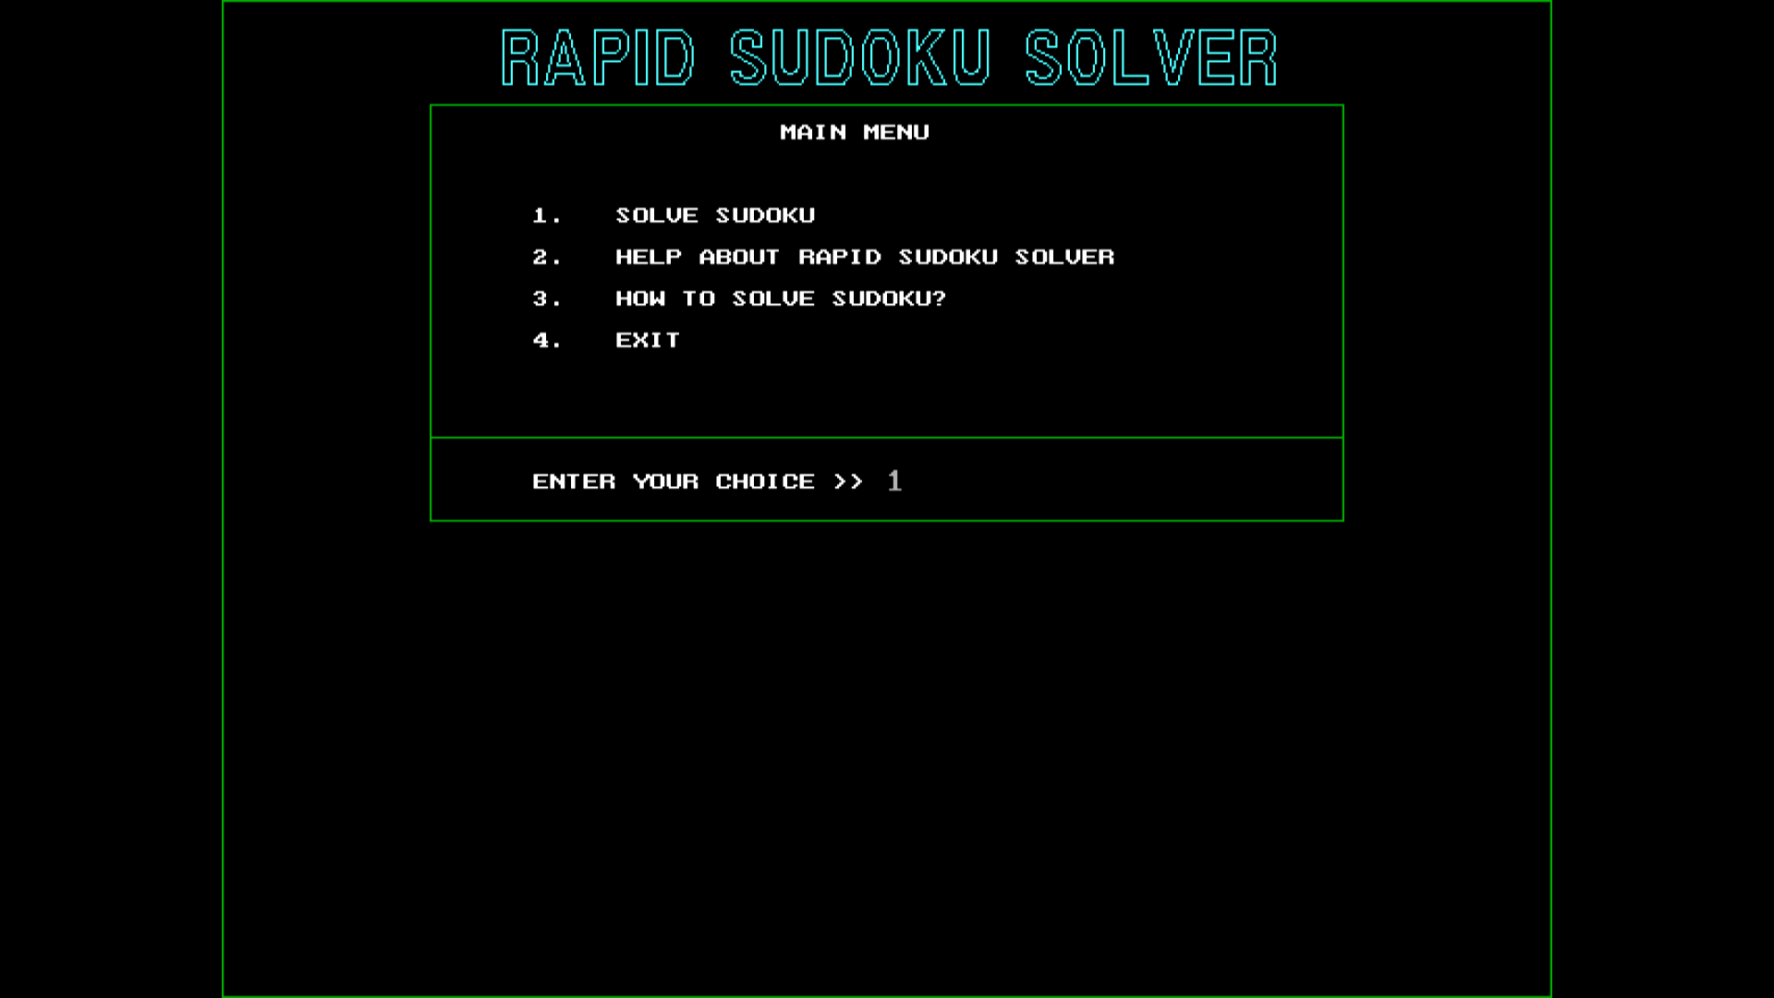
Sample Output

Slide 15
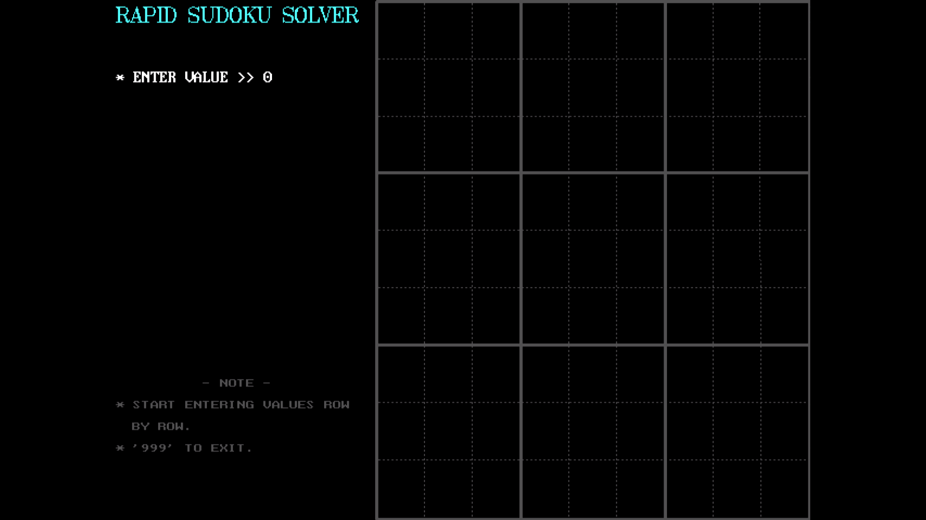

Slide 16
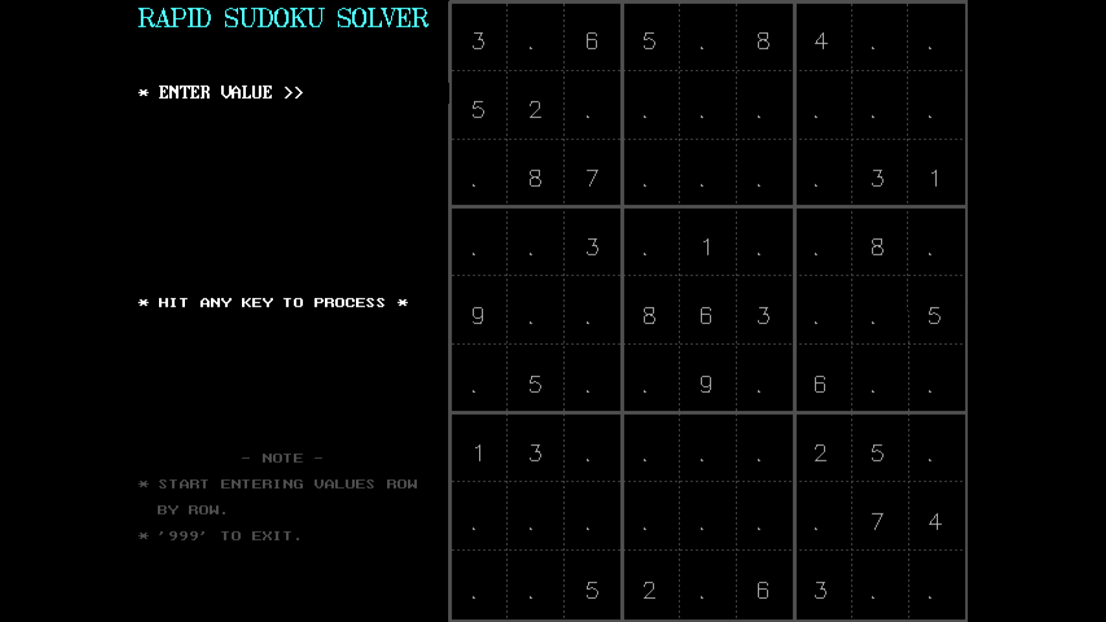

Slide 17
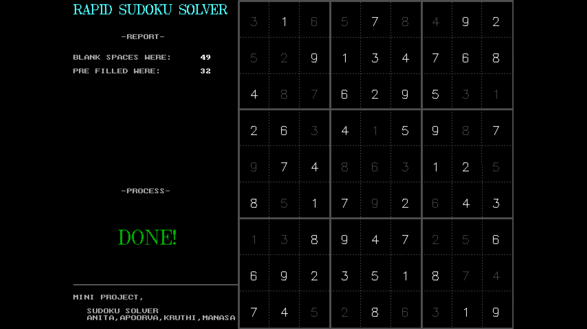

Slide 18
THANK YOU
ANY QUESTIONS ?

